Slide 1
Transistors

Slide 2
Introduction
The invention of the bipolar transistor in 1948 ushered in a revolution in electronics.
Bipolar transistors consist of either a P-N-P or an N-P-N semiconductor "sandwich" structure.
The three leads of a bipolar transistor are called the Emitter, Base, and Collector.
Difference between PNP and NPN transistor is the proper biasing of junctions. Current directions and voltage polarities for each type of transistor are exactly opposite
Base
Emitter
Collector
c
c
E
E
N
P
N
B
B
Base
Emitter
Collector
E
c
E
N
P
c
P
B
B

Slide 3
Transistor Mode of Operation
Condition | Emitter junction | Collector junction | Region of operation
FR | Forward-biased | Reverse-biased | Active
FF | Forward-biased | Forward-biased | Saturation
RR | Reverse-biased | Reverse-biased | Cutoff
RF | Reverse-biased | Forward-biased | Inverted
Biasing an NPN transistor for active operation
N
P
N
E
C
Emitter
Base
Collector
Space
charge
B
Space
charge
-
+
-
+

Slide 4
Contd.
Collector current is less than emitter current
A part or emitter current consists of holes that do not contribute to collector current
Not all the electrons injected into the base are successful in reaching collector.
Ratio of collector current to emitter current is typically 0.99 denoted by α_{dc}
Collector current made up of two parts
Fraction of emitter current which reaches the collector
Reverse leakage current I_{CO}
Total current equation

Slide 5
Problem
An NPN transistor has of α_{dc} 0.98 and a collector leakage current of 1 uA. Calculate the collector and base current, when emitter current is 1 mA.

Slide 6
Transistor amplifying action
E
C
+
+
+
~
5 kΩ
-
-
B
-
Transfer + resistor = transistor

Slide 7
Different configurations of transistor
E
C
C
E
B
B
+
+
+
+
B
+
~
+
~
~
E
-
C
-
-
-
-
-
Figure shows three configuration from ac point of view.
In all configurations, emitter-base junction is always forward-biased and collector base junction is always reverse-biased.

Slide 8
Transistor characteristics
Static characteristic curves to relate current and voltage in a transistor.
Input characteristic
Output characteristic

Slide 9
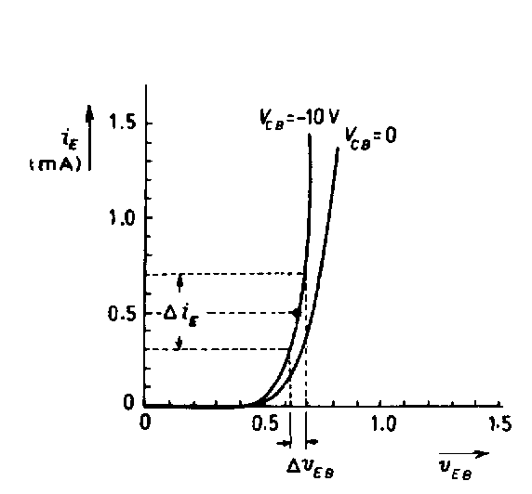
Common-Base Input characteristics
+
-
E
C
+
-
mA
mA
+
-
V
B
V
-
+

Slide 10
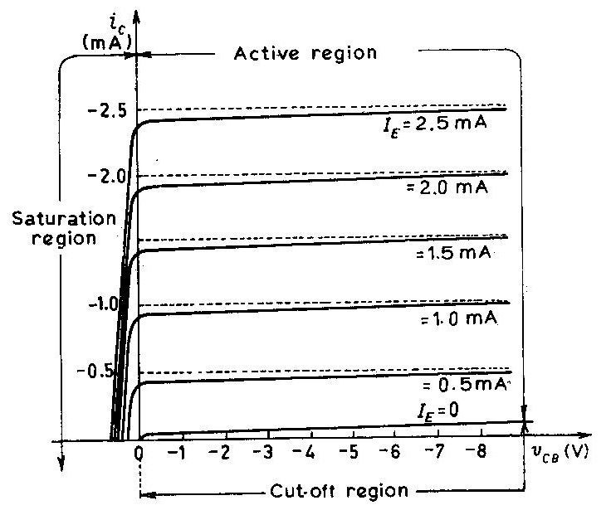
Common-Base output characteristics
High output resistance – can be good current source
Saturation region - collector current not remain same with change in emitter current
Cut-off region- collector current is not zero even emitter current is zero due to leakage current I_{CB0} OR I_{CO}

Slide 11
Summary of C-B characteristics
Current gain slightly less then unity (~0.98)
Dynamic input resistance very low (~ 20 ohm)
Dynamic output resistance very high (~ 1 M ohm)
Leakage current very low (~ 0.02 uA for Si transistor)

Slide 12
C-E Configuration
C
C
B
N
E
+
B
+
+
P
+
N
-
-
-
-
E
Mostly work in active region

Slide 13
Contd.

Slide 14
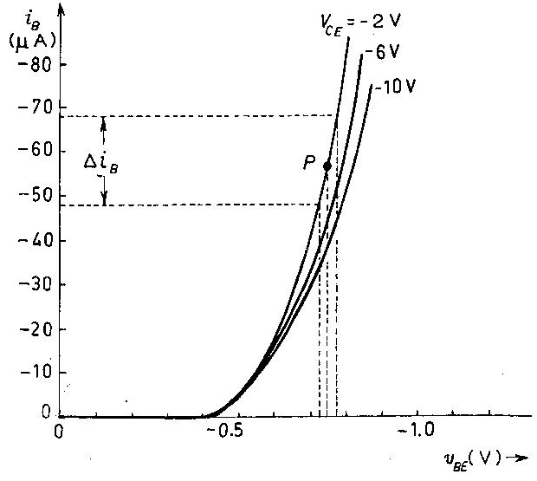
C-E input characteristics
+
-
mA
C
-
+
B
-
µA
V
-
+
V
E
+

Slide 15
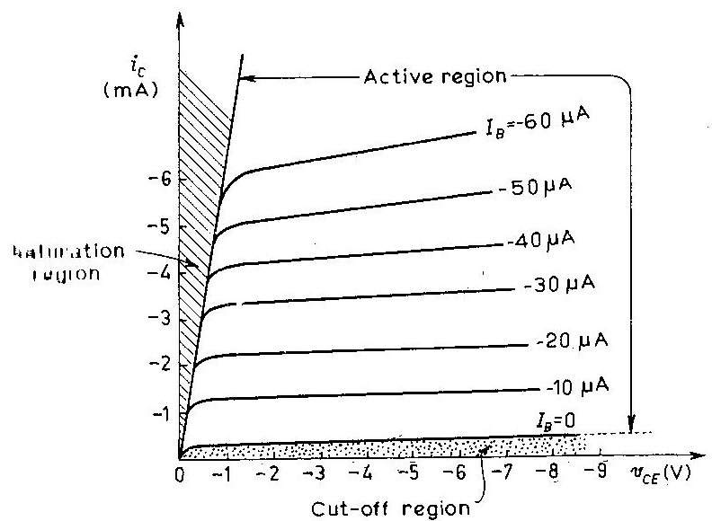
C-E output characteristics
Current gain increase with Vce
Small base current produce large change in collector current
Large leakage current I_{CEO}

Slide 16
Comparison between CB and CE
Parameters | Common – base Configuration | Common – emitter Configuration
Input dynamic resistance Output dynamic resistance Current gain Leakage current | Very low (20 Ω) Very high (1 MΩ) Less than unity (0.98) Very small (5 µA for Ge, 1 µA for Si) | Low (1 kΩ) High (10 kΩ) High (100) Very large (500 µA for Ge, 20 µA for Si)
Leakage current lead to Thermal Runway

Slide 17
Problems
When emitter current of transistor changed by 1mA, its collector current changed by 0.995 mA. Calculate
CB current gain
CE current gain
The DC current gain of a transistor in CE configuration is 100. Find DC current gain in CB configuration.

Slide 18
Why CE configuration widely used
Amplifier stage 1
Amplifier stage 2
~
A good amplifier stage is one which has high input resistance and low output resistance
Current gain is more in CE configuration

Slide 19
Common-collector configuration
C
E
B
B
+
~
C
E
-
Emitter current as a function of base current

Slide 20
Contd.

Slide 21
CC characteristics
High input resistance (~ 150 k ohm)
Low output resistance (~ 800 ohm)
High current gain (~100)
Low voltage gain (less then unity)

Slide 22
Basic CE amplifier circuit
C
+
B
+
E
˜
-
-

Slide 23
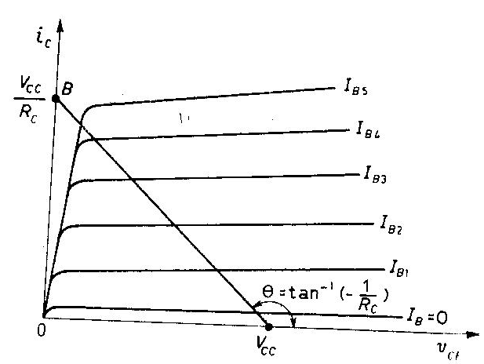
DC load line
C
+
-
B
+
+
-
E
-

Slide 24
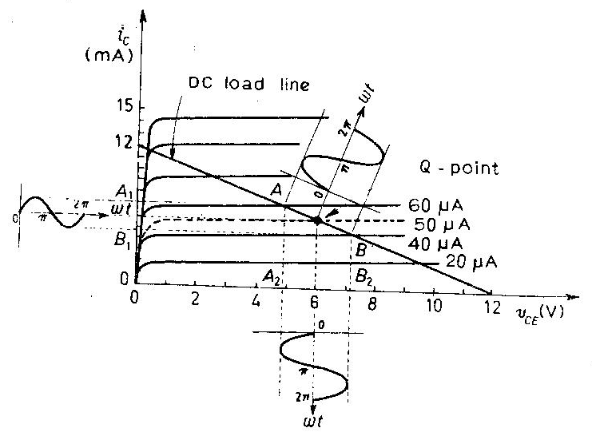
Amplification and Q-point
=

Slide 25
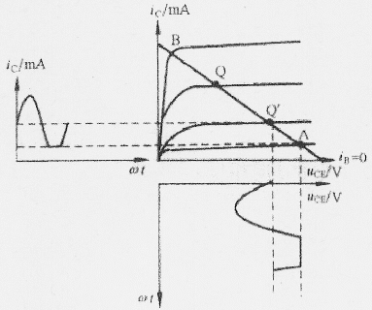
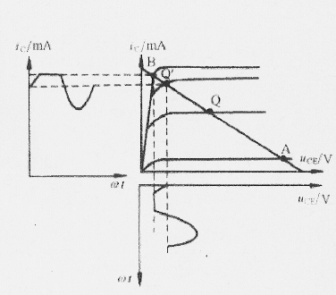
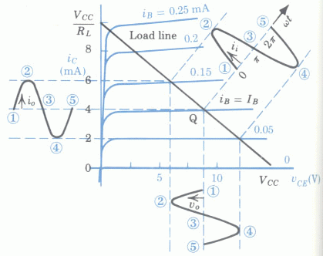
Selection of Q-point

Slide 26
Logic Gate Using Transistor

Slide 27
Transistor as a switch
Transistor's collector current is proportionally limited by its base current, it can be used as a sort of current-controlled switch. A relatively small flow of electrons sent through the base of the transistor has the ability to exert control over a much larger flow of electrons through the collector
When a transistor has zero current through it, it is said to be in a state of cutoff
When a transistor has maximum current through it, it is said to be in a state of saturation.
Switch
NPN transistor
PNP transistor
Switch

Slide 28
Inverter
Closed switch
Open switch
0 input = open switch = output 1
1 input = close circuit = output 0

Slide 29
NOR Gate
C
A
B

Slide 30
OR Gate
C
A
B

Slide 31
AND Gate
C
A
B

Slide 32
NAND Gate
??

Slide 33
XOR Gate
??

Slide 34
Transistor Biasing Circuit

Slide 35
Stabilization of Q-point
Requirement of biasing circuit
Operating point in the centre of active region
Stabilization of collector current against temperature variations
Making operating point independent of transistor parameters
Different biasing techniques used for achieving these points
Temperature continues to increase
T
T

Slide 36
Fixed Bias

Slide 37
Steps for calculating Q-point in fixed bias
Calculate base voltage, in case V_{BE} is known, use more accurate calculation.
Calculate collector current from base current, make sure its not greater than I_{c(sat)}
Calculate collector-emitter voltage

Slide 38
Problem
Calculate the Q-point for the circuit given in figure
300 kΩ
2 kΩ

Slide 39
Problem
Calculate
Q-point in circuit. Given R_{C}=1 k ohm and R_{B}=100 k ohm
If transistor is replaced by another unit of beta=150 instead of 60. Determine its new Q-point.
AC125

Slide 40
Problem
In a given circuit, a supply of 6 V and a load resistance of 1 k ohm is used.
Find the value of resistance R_{B} so that a germanium transistor with β=20 and I_{CBO}=2uA draws an I_{C} of 1 mA.
What Ic is drawn if the transistor parameters change to β=25 and I_{CBO} = 10 uA due to rise in temperature ?
1 kΩ

Slide 41
Fixed bias features
Advantages
Very simple
very few component
Easy to fix Q point by changing R_{B}
Limitations
Thermal runway
Strongly β dependent Q-point
Leads to thermal runway
T
T
T

Slide 42
Bias circuit with emitter resistance
₊
-
₊
-
₊
-
Rising tendency is checked
T
Rising tendency is checked
β

Slide 43
Contd.

Slide 44
Features of bias circuit with emitter resistance
Advantages
Provide good stabilization of Q-point against temperature and β variation
Limitations
Emitter resistance provide a feedback causes reduction in voltage gain.
For getting very good stabilization
For large R_{E}, high DC source is required
For small RB, low DC source is required
10 v
1 MΩ
2 kΩ
₊
₊
1 kΩ
-
-
>>
Problem: Calculate values
of 3 currents

Slide 45
Voltage divider biasing circuit
Source
shortage

Slide 46
Problem
Find Q point
+12 v
40 kΩ
5 kΩ
₊
₊
5 kΩ
1 kΩ
-
-

Slide 47
Wish you all a very successful career and happy life

